Slide 1
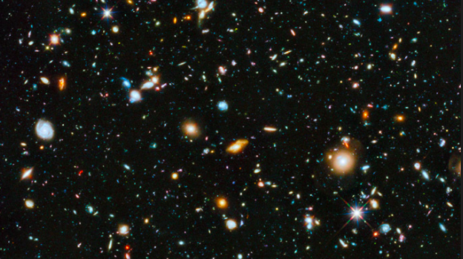
SKYSURF: Measuring the Brightness of the Sky
Presented by: Jessica Berkheimer
Mentors: Rogier Windhorst, Timothy Carleton
jberkhei@asu.edu

Slide 2
SKYSURF: Measuring the Brightness of the Sky
Motivation:
Despite how dark the night sky appears, our view of the Universe is clouded by light from within our Solar System.
Knowing the level of extragalactic background light can help us understand where that light comes from. Is it diffuse galaxies and galaxy clusters in our own backyard, or echoes of light from the first stars?
Goal:
To answer the questions:
  Do all the galaxies we see in the images account for the extragalactic (and extrasolar) light?
  Are there other sources of light that we haven't identified yet, such as debris from merging galaxies, light from the earliest galaxies?
Jberkhei@asu.edu

Slide 3
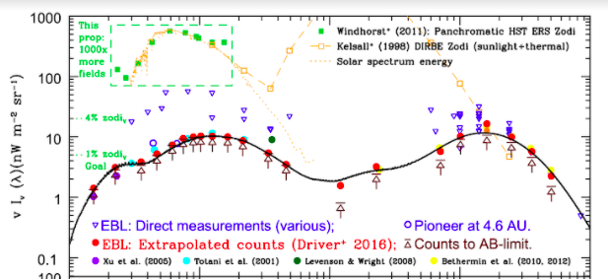
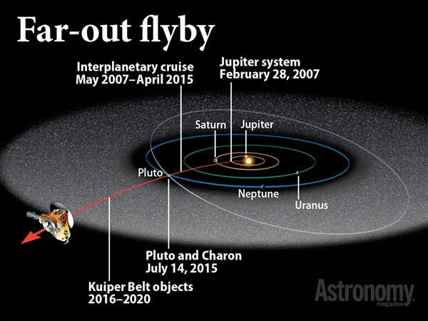
SKYSURF: Measuring the Brightness of the Sky
Retrieved from https://astronomy.com/magazine/ask- astro/2014/01/new-horizons
This is an outside-in view of the solar system showing the New Horizons probe. All the grey dots contribute to the zodiacal light
Wavelength
Background light levels as a function of wavelength – galaxies make up the red points, and direct measurements are the blue points. SKYSURF will help address the difference.
jberkhei@asu.edu

Slide 4
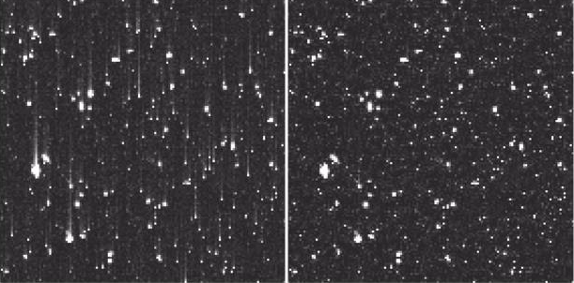
SKYSURF: Measuring the Brightness of the Sky
Before Correction After Correction
When cameras on HST take an image, light hits pixels in the camera, and knocks off some electrons. These charges are then read down the camera at the end of the exposure. However, the process of reading down change transfer is imperfect. There is a correction to this effect that is applied after the fact, however we need to make sure that that correction isn't affecting our measurement.
Retrieved from https://hst-docs.stsci.edu/acsdhb/chapter-4-acs-data-processing-considerations/4-6-wfc-ccd-detector-charge-transfer-efficiency-cte
Charges have been imperfectly transferred up the image.
jberkhei@asu.edu

Slide 5
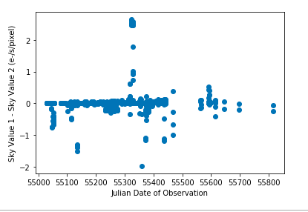
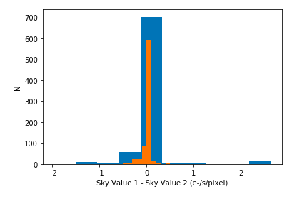
SKYSURF: Measuring the Brightness of the Sky
The plots demonstrate the difference between the two calibrations. By comparing measurements using various calibrations, we will determine if our sky brightness measurements are accurate. The small difference between the two calibrations, and the lack of correlation between the difference in time, suggests that it is not affecting our measurements.
jberkhei@asu.edu

Slide 6
Questions…
jberkhei@asu.edu

